Slide 1

Mid-semester Reviews
SEP Team 5

Slide 2

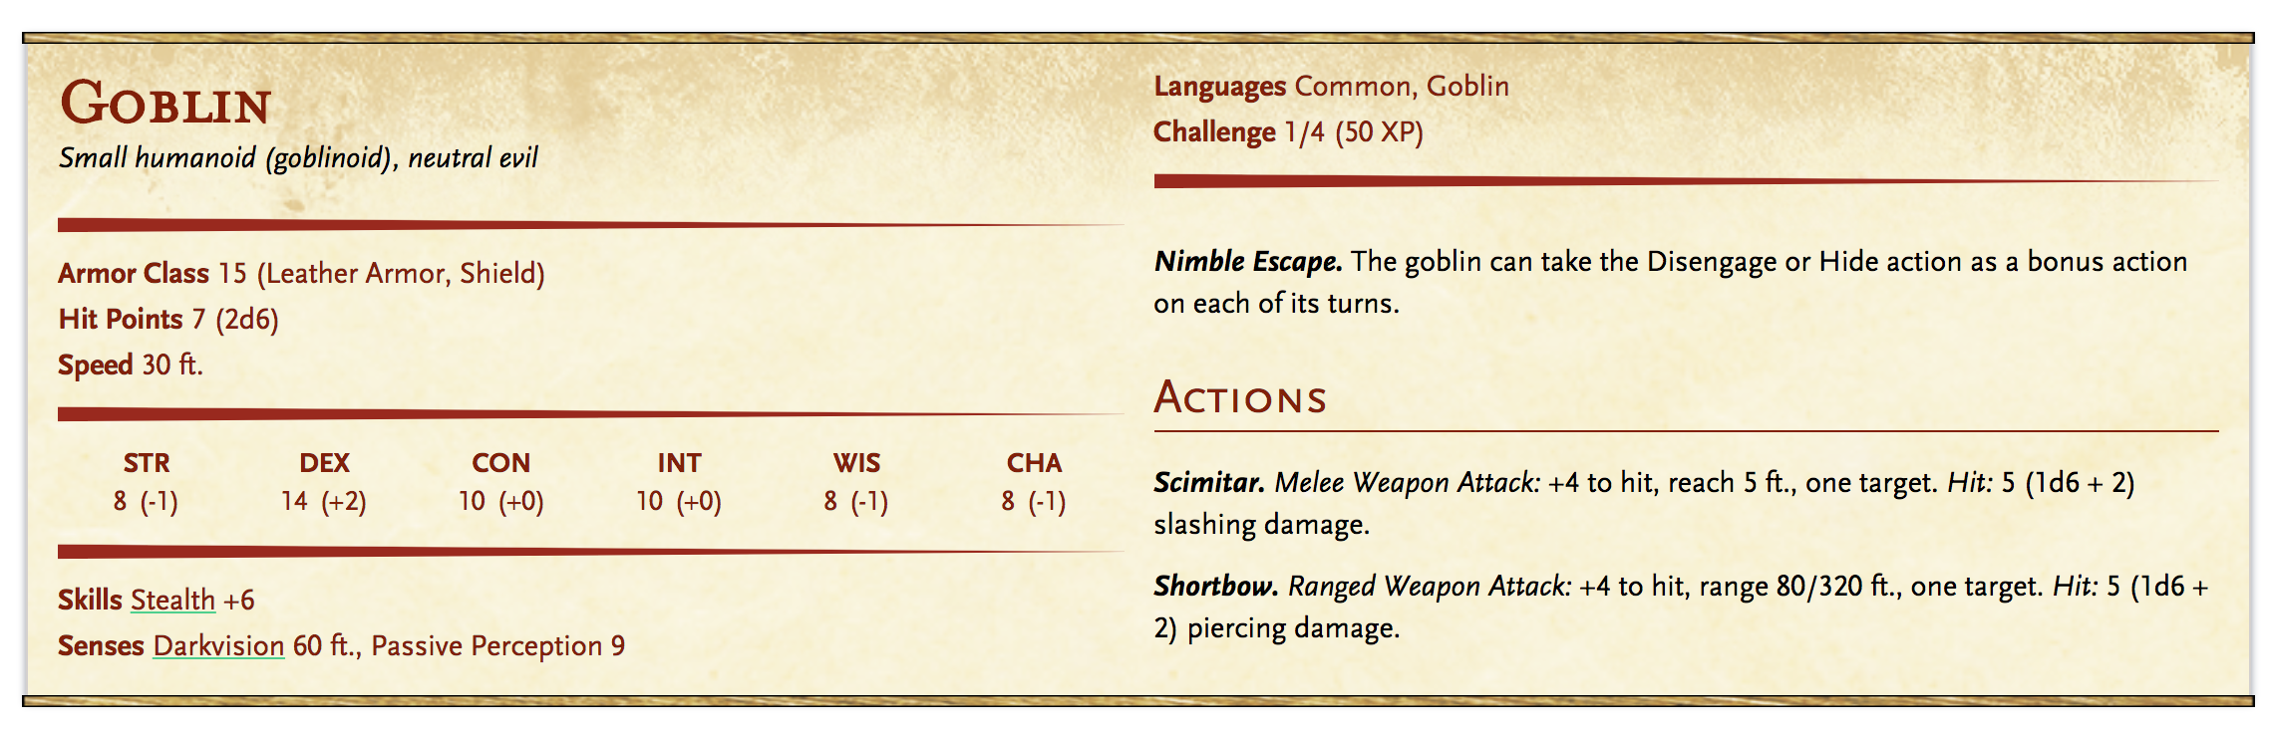
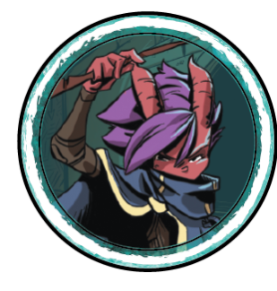
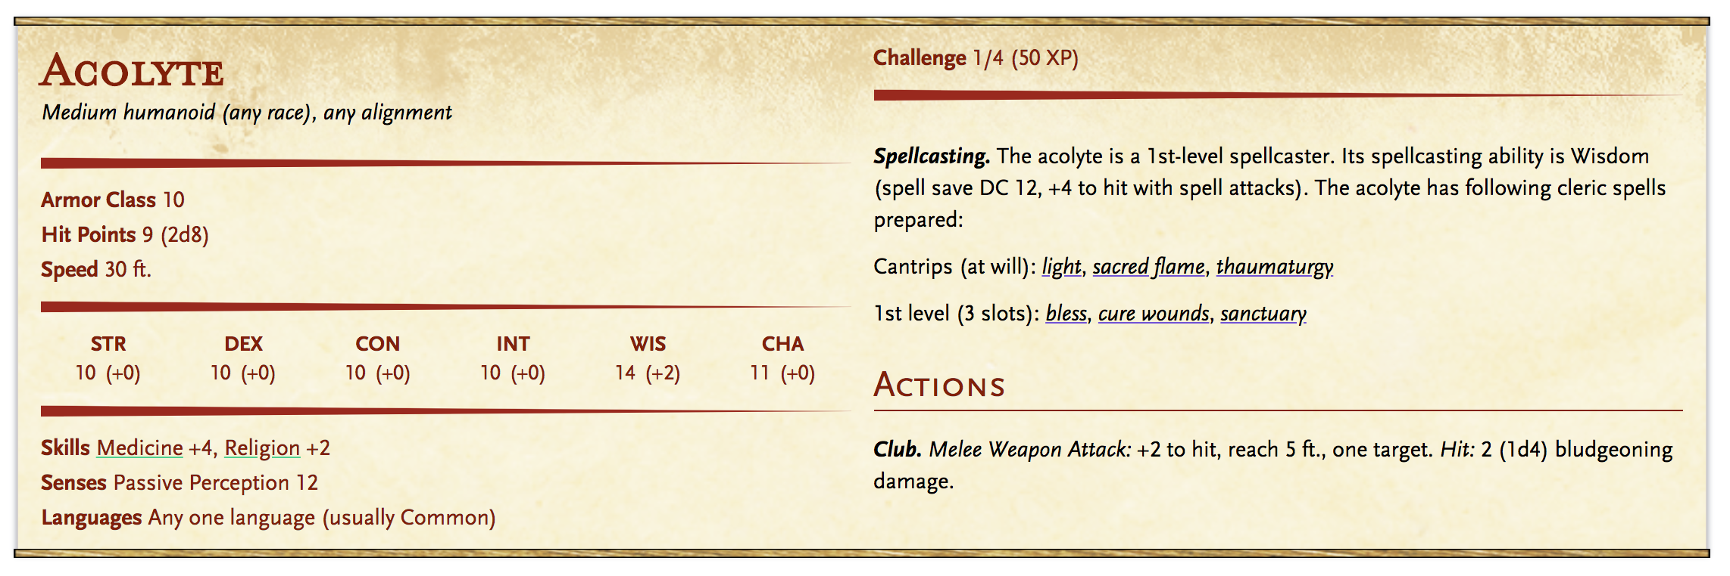
Product Overview (Review)
Things the narrator keeps track of:
Where are the characters?
How healthy are the characters?
What can/would each of the characters do?
How can each of the characters do this?
What does the character have with them and why?
And more...
Our Goal: Providing a centralized means of organizing and generating details for playing through encounters inside a campaign
Notes:
Same as project pitch so not adding notes

Slide 3
Framework Plans
Sprint 1:
Electron and Electron Webpack
Material UI
Enzyme and Jest Testing
TypeScript
PostgresSQL
Azure Hosting
React
Node JS
Sprint 4+:
Electron and Electron Webpack
Material UI Bloomer/Bulma
TS-Enzyme and TS-Jest Testing
TypeScript
PostgresSQL and TypeORM
Azure Hosting Amazon Web Services
React and React Dev Tools
Node JS with Hapi, Joi, and Boom
Nock (Http Mocking)
React Router
Electron Store (Cookie Management)
JSON Web Token (JWT)
Docker
Notes:
Self explanitory

Slide 4
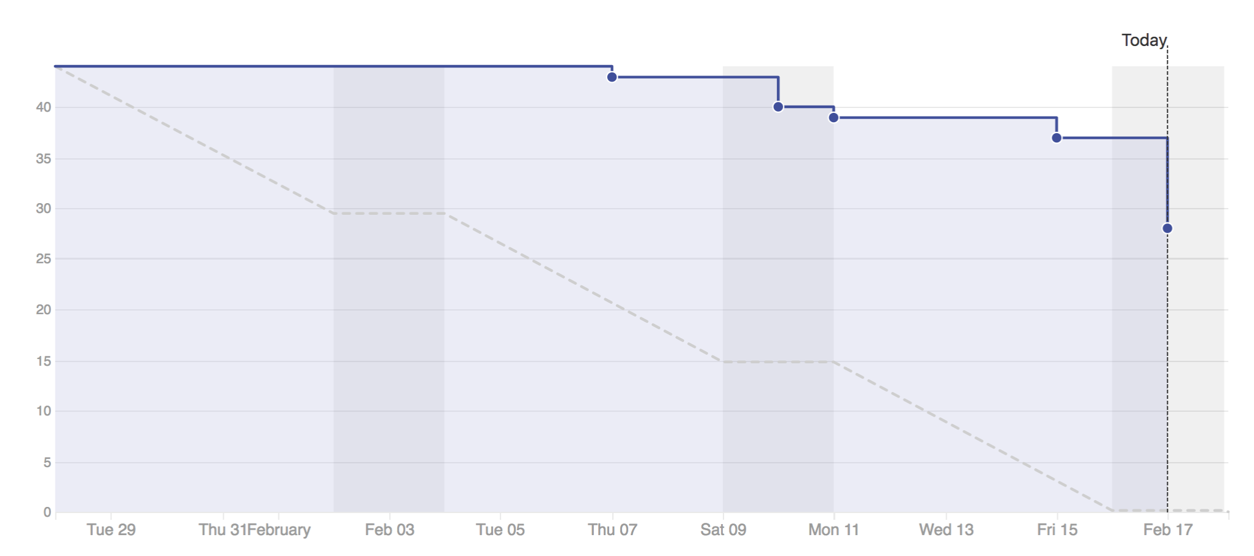
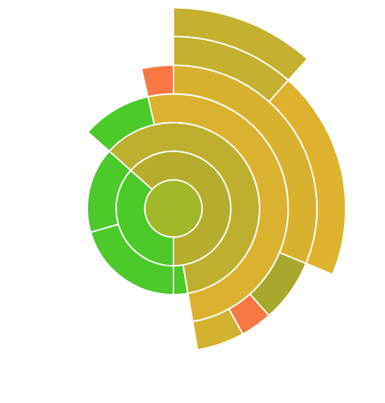
Sprint 1 Milestones
Basic application setup
Completed database schema
Frontend and Backend for login and registration completed
Frontend for monster creation started
Initial lofi sketches made
Adding Electron, Node, Docker, AWS, TypeORM, and Material UI
91% code coverage
45 point capacity
Notes:
Milestones self explanatory
We overestimated how much time we had and so our burndown and capacity suffered.

Slide 5
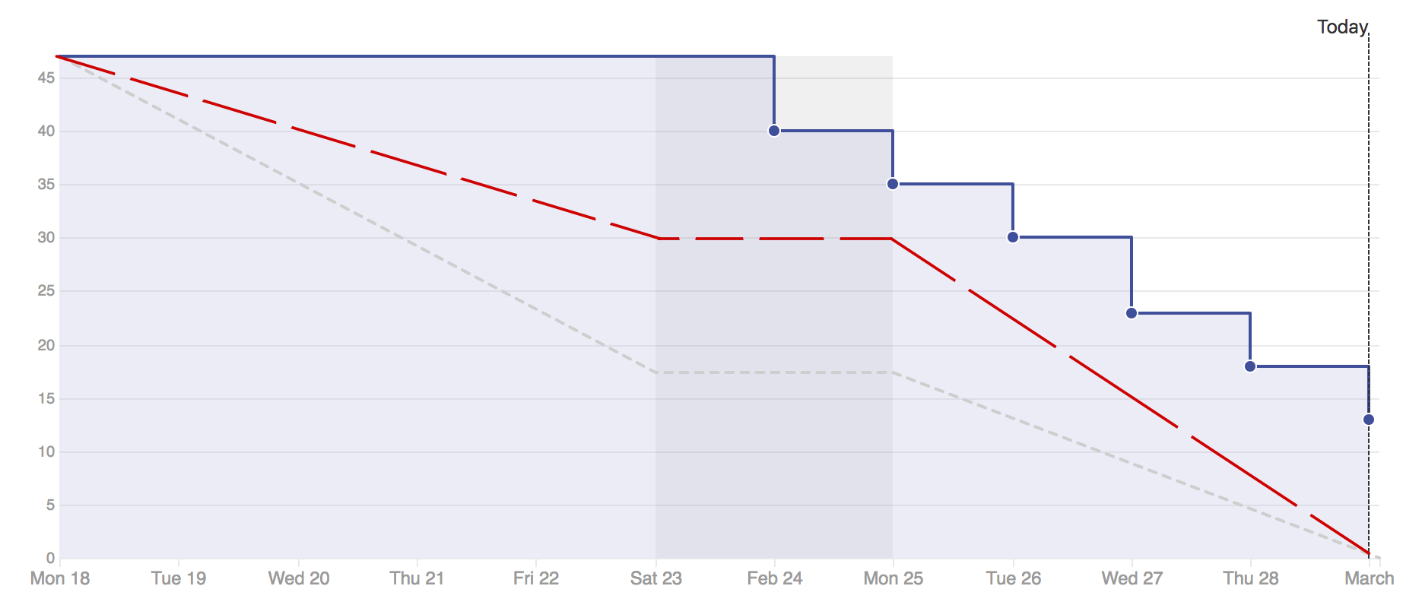
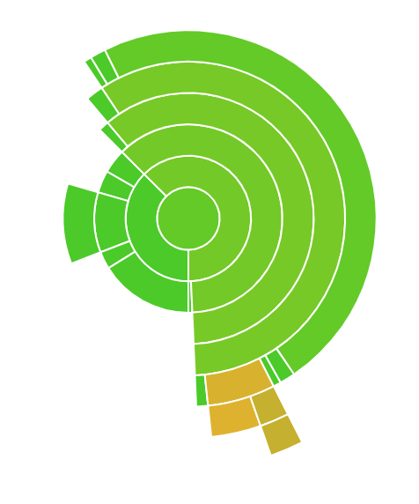
Sprint 2 Milestones
React Router added (+ navbar)
Session tokens and cookie management started
Database populated with pre-gathered data for current features
Prior features integrated from sprint 1
Switch to TS testing frameworks, add devtools, add type checking to backend, and http mocking
92% code coverage
43.8 point capacity
Notes:
Milestones are hopefully self explanatory
We started getting better at burndown but while we estimated rightm we didn’t take into account for team members absences and so our reviews suffered and we finished the day after the sprint ended as we struggled to catch up

Slide 6
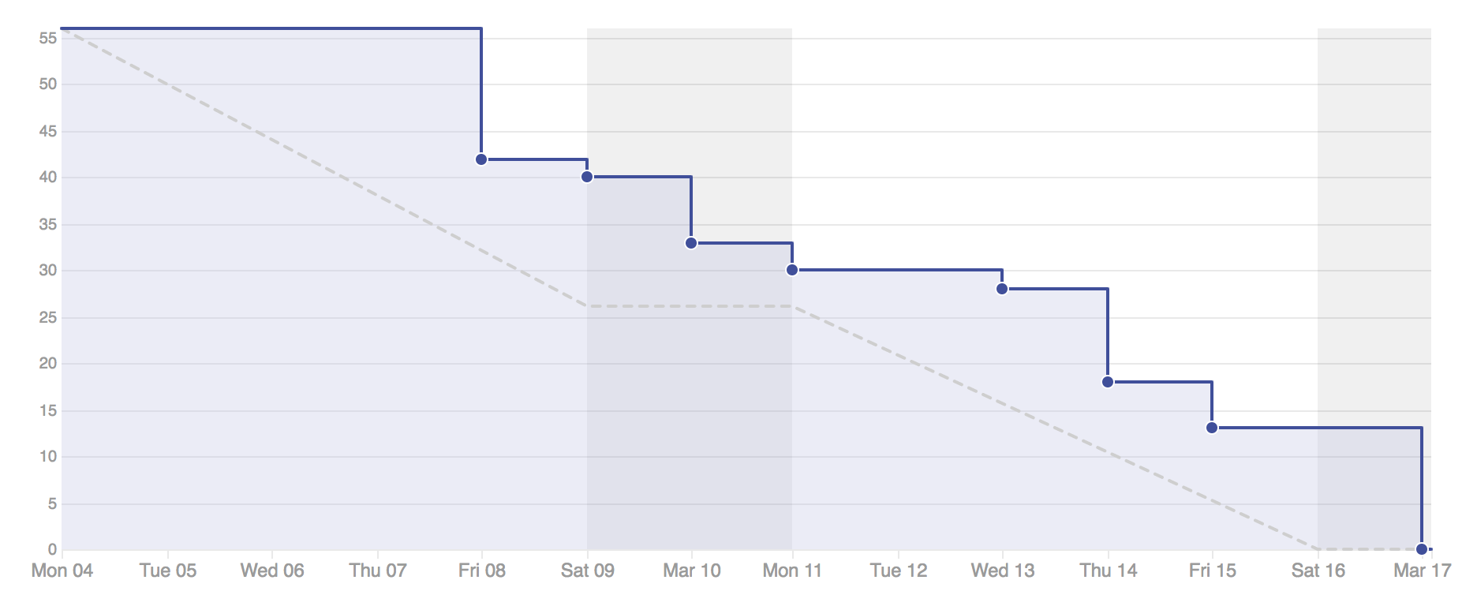
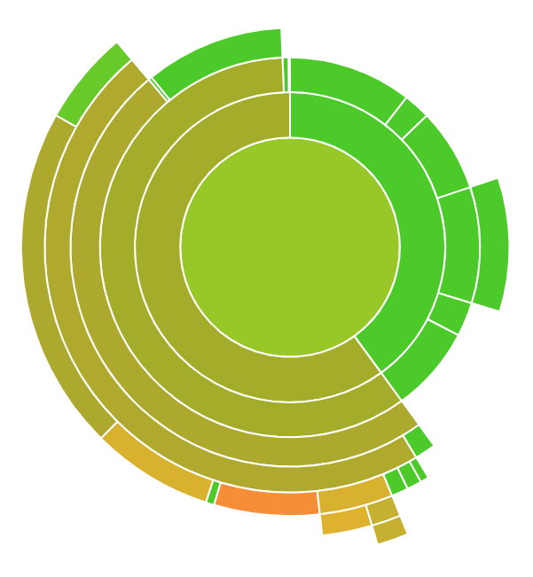
Sprint 3 Milestones
Material UI -> Bulma and Bloomer
Secured application via session token checking for pages
Cookie management
Optimized API URL referencing and Docker Building
Updated DB w skill data
Create encounter
93% code coverage
52 point capacity
Notes:
Milestones are hopefully self explanatory.
52 point capacity but we took a little more (55) to cover for some stuff we didn’t complete last sprint
We had code done but not reviewed until after the weekend, unfortunately, but a bit more on track now

Slide 7
Future Milestones
MVP:
Update and Delete Monster [Sprint 4]
Read, Update, Delete Encounters [Sprint 4]
CRUD Campaigns [Sprint 4]
Paginated Views of Catalog Entries (Monsters, Encounters, Campaigns) [Sprint 4 - Sprint 5]
CRUD basic entries for player characters [Sprint 5]
Running through an Encounter [Sprint 5 - Sprint 6]
Enhancements to MVP:
CRUD for additional catalog entries (Items, Locations, etc) [Sprint 6]
Enhancements to running through an encounter (Auto generated fields, etc) [Sprint 6]

Slide 8
Product Demonstration
Notes:
[David w/ Yusuf’s Laptop]
Start signed in
Create a monster v v fast
Show the contents of catalog / a la view
Show create encounter
Show maybe the view encounter if we can

Slide 9
Questions? Comments? Concerns?

